Slide 1
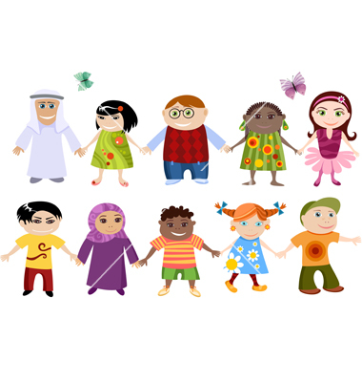
MY NEW FRIENDS FROM ALL OVER THE WORLD

Slide 2

CHINA

Slide 3

KOREA

Slide 4

USA

Slide 5
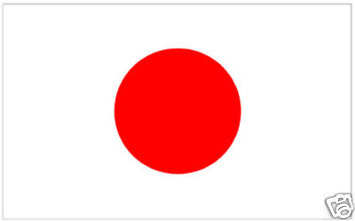
JAPAN

Slide 6

INDIA

Slide 7
Chen, where are you from?.
I am from China!
Chen

Slide 8
Yumiko, where are you from?
I am from Japan!
Yumiko

Slide 9

Jin, where are you from?
I am from Korea!

Slide 10

Susan, where are you from?
I am from USA!

Slide 11

Lia, where are you from?
I am from India!!

Slide 12

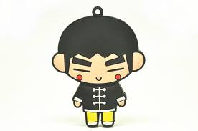
I am from CHINA

Slide 13

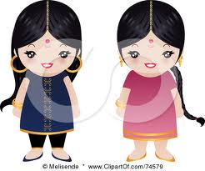
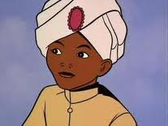
We are from INDIA

Slide 14
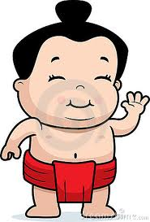
I am from JAPAN

Slide 15
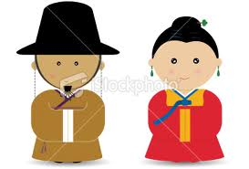
WE ARE FROM KOREA

Slide 16

WE ARE FROM USA

Slide 17
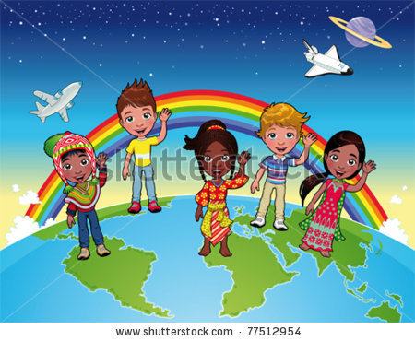
See you!!!!

